Slide 1
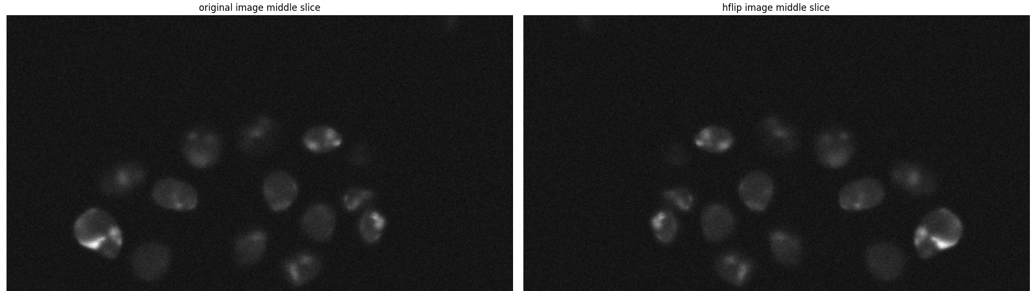
27/6/2024
Testing the augmentations

Slide 2
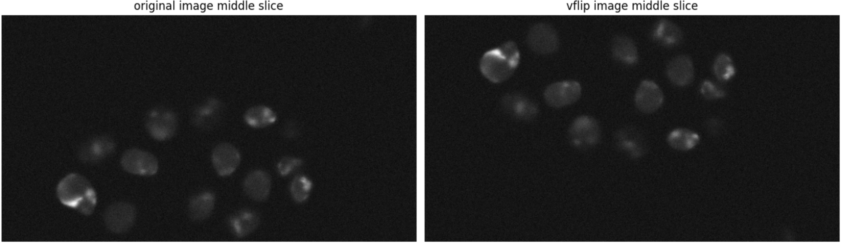
27/6/2024
Testing the augmentations

Slide 3
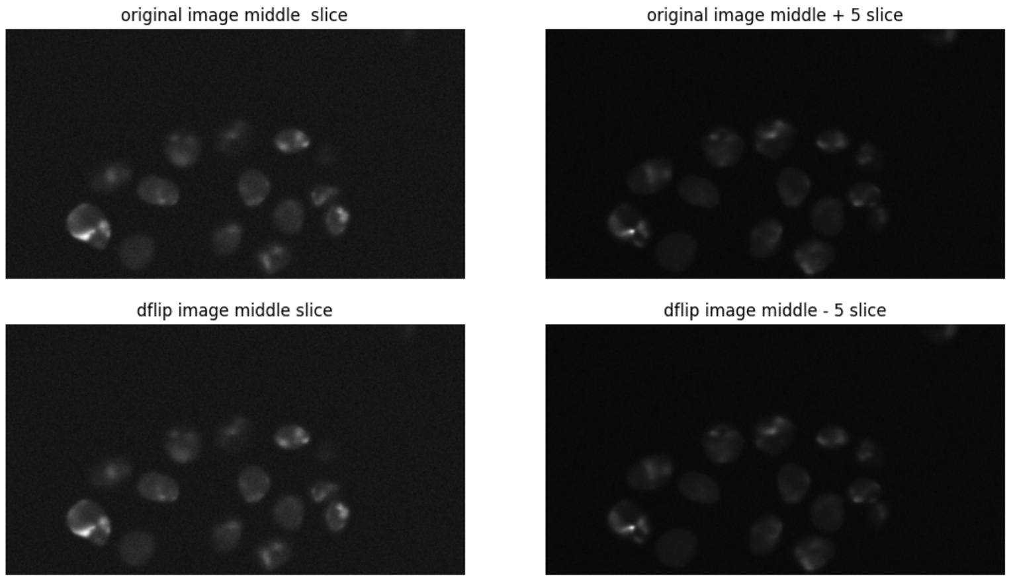
27/6/2024
Testing the augmentations

Slide 4

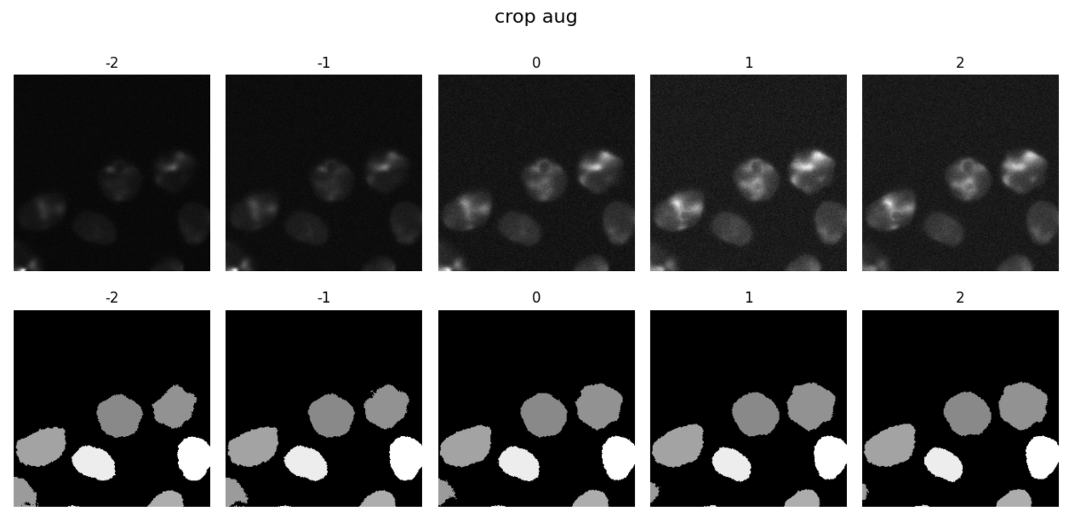
27/6/2024
Testing the augmentations

Slide 5
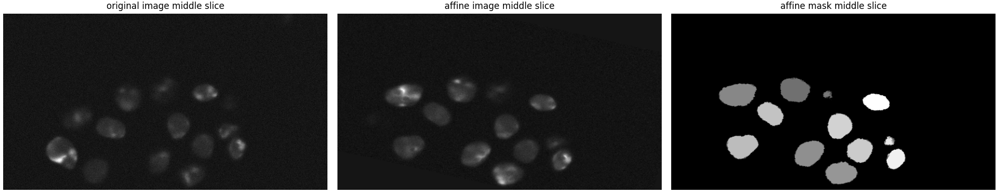

27/6/2024
Testing the augmentations

Slide 6
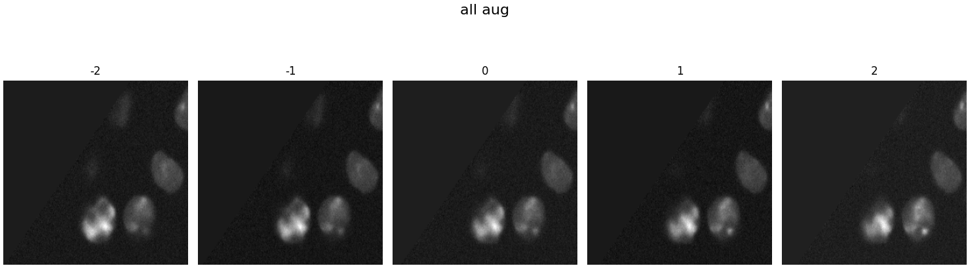
27/6/2024
Testing the augmentations

Slide 7
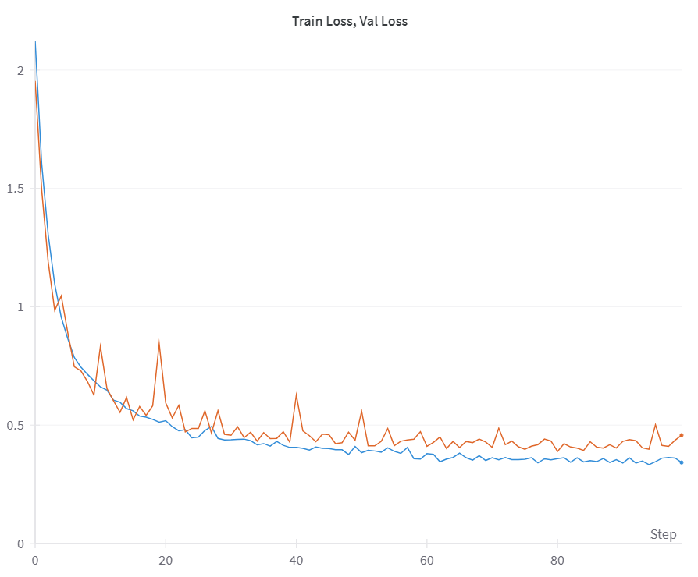

28/7/2024
3d-unet without markers, CE

Slide 8
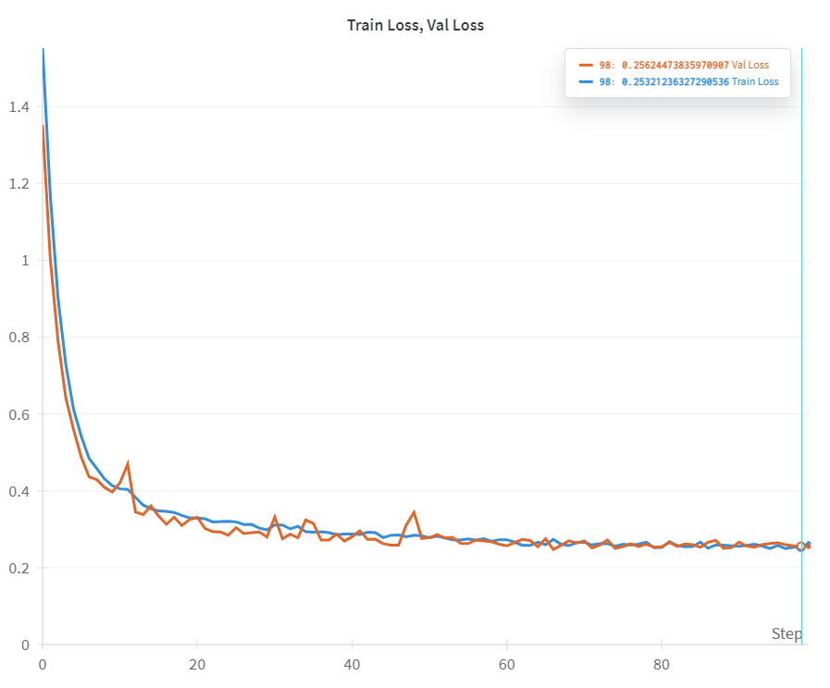

28/7/2024
3d-unet without markers, DICE-CE

Slide 9
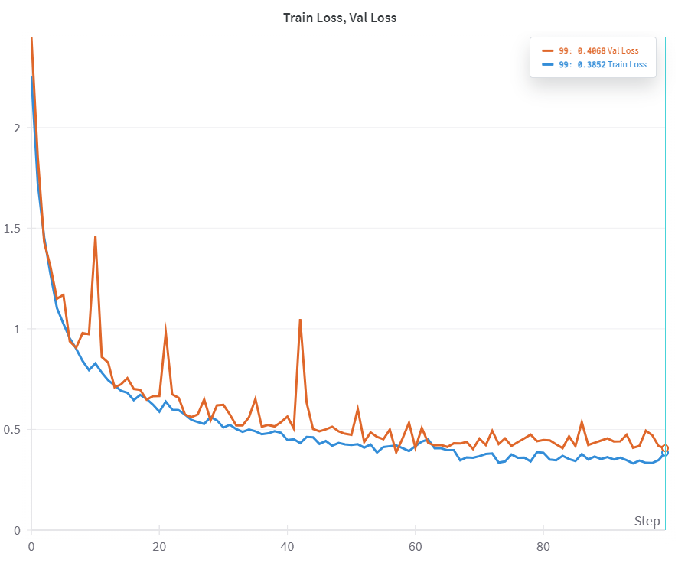

29/7/2024
3d-unet with markers, CE

Slide 10
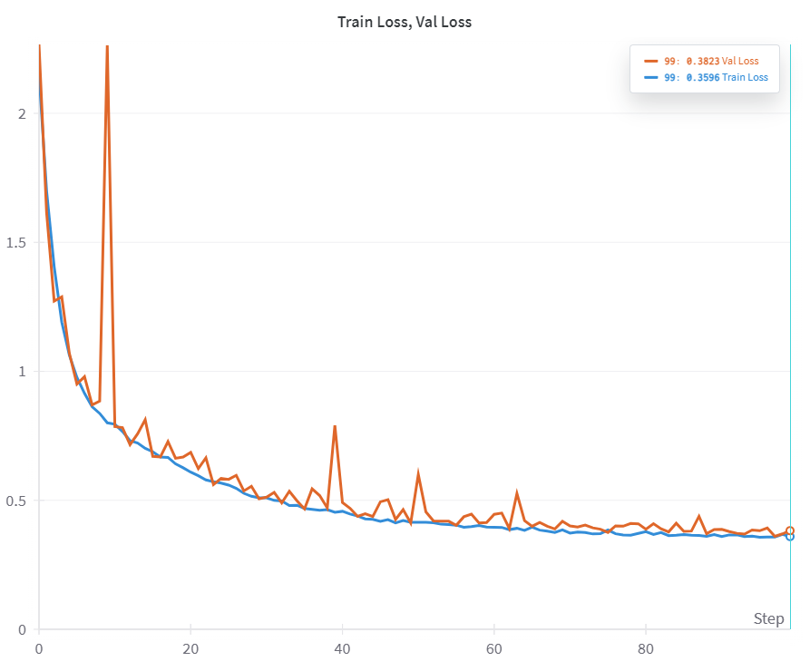

29/7/2024
3d-unet with markers, DICE-CE

Slide 11
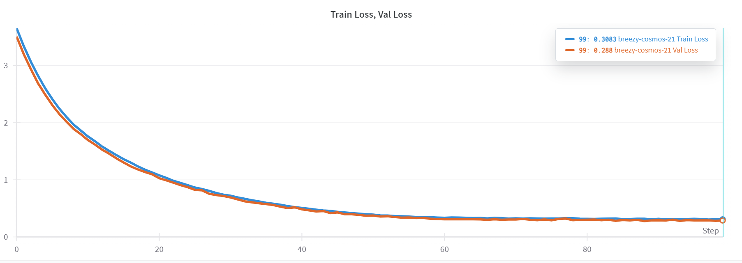

3/8/2024
VIT_UNET WITHOUT MARKERS
Notes:
Run 21 in wandb

Slide 12
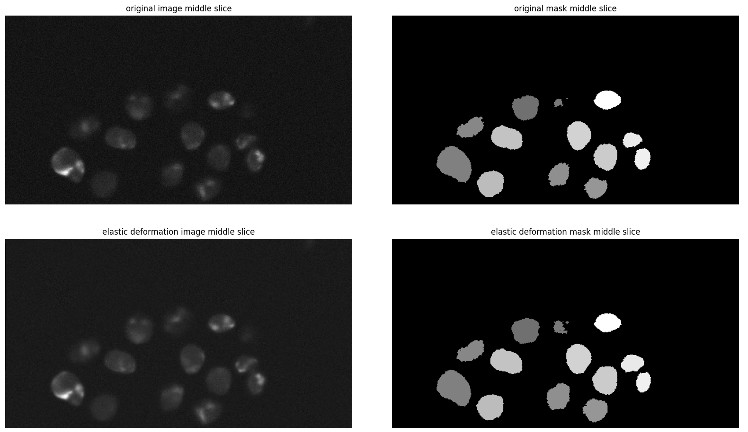
10/8/2024
Testing the augmentations

Slide 13
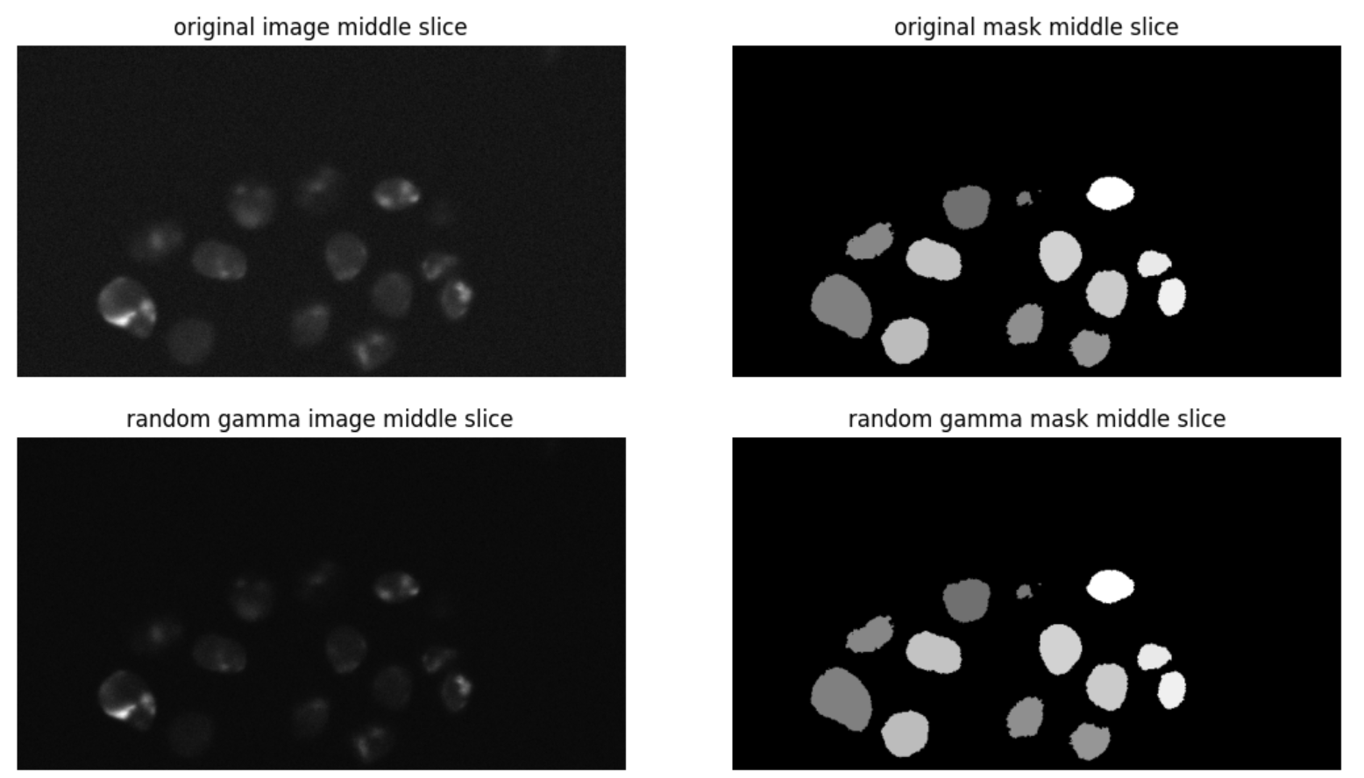
10/8/2024
Testing the augmentations

Slide 14
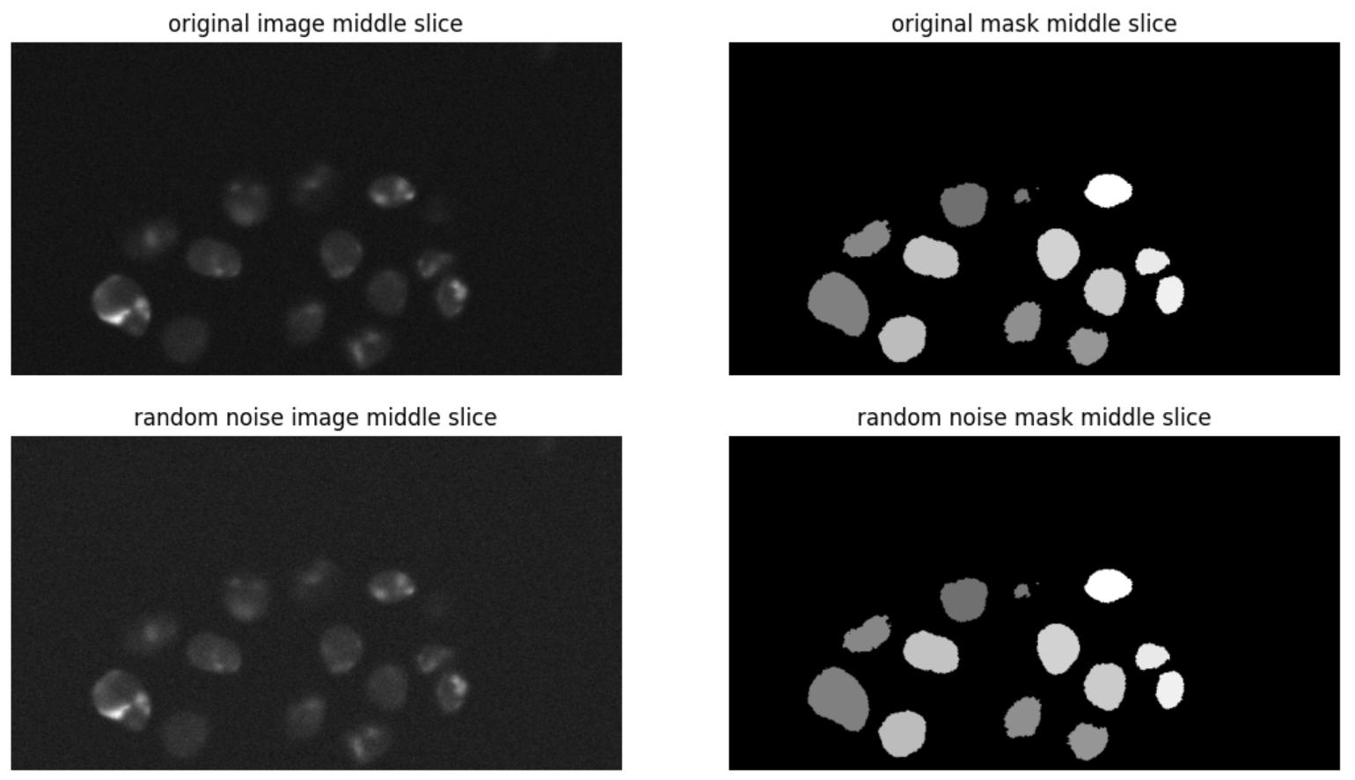
10/8/2024
Testing the augmentations

Slide 15
11/8/2024
VIT_UNET WITH MARKERS

